Slide 1

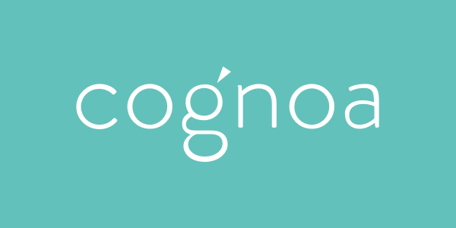

AI to Revolutionize Child Behavioral Diagnostics & Therapeutics
Halim Abbas
Chief AI Officer - Cognoa Inc.
Apr 2019

Slide 2
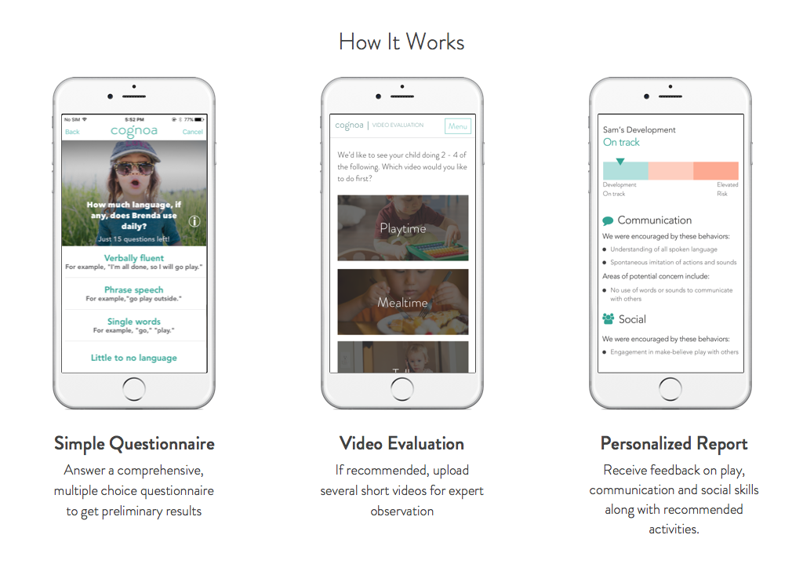

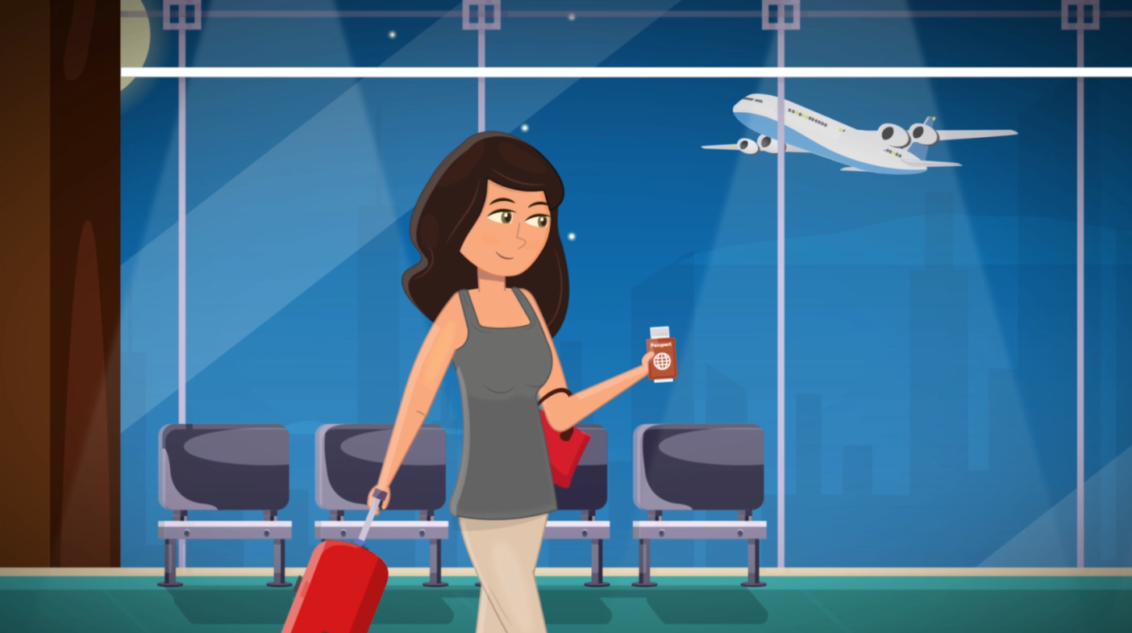
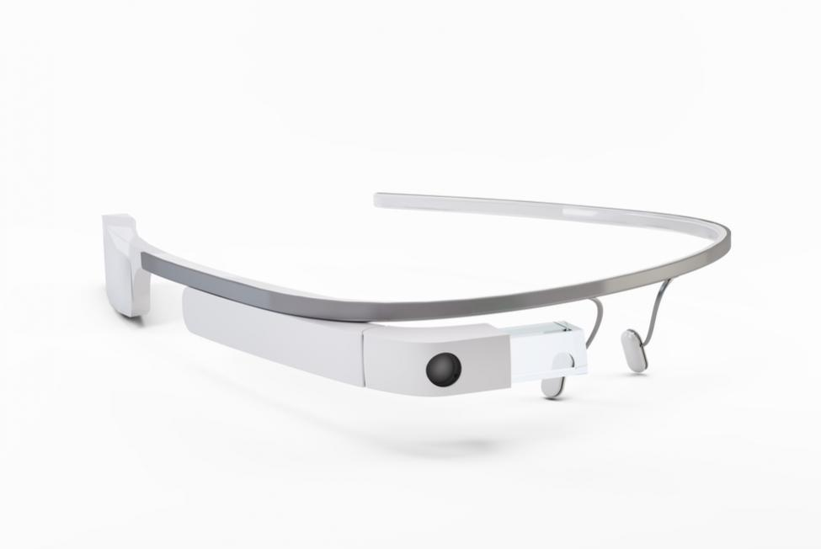
AI
perceiving
Diagnostics
classifying
Therapeutics
forecasting
planning
Notes:
Hello everyone. My name is Halim and I am the head of DS at Cognoa, which is a pediatric behavioral health startup based in Palo Alto, CA.
At Cognoa, we build AI-enabled diagnostic and digital therapeutic tools for young children at risk for behavioral or developmental conditions like autism and ADHD, speech&language delays and the like.
You can think of us as operating in the intersection of behavioral science, pediatric healthcare, and Artificial Intelligence.
And as most of you know, AI is an umbrella term that covers a very big family of computer algorithms that enable machines to do all sorts of smart things - so I feel I need to qualify what specific flavors of AI we use at Cognoa with this diagram. We use computer perception (i.e. vision and audio analysis) as well as Machine Learning classification to power our diagnostic features, and planning and forecasting algorithms to power our digital therapeutic features.
Today, in the interest of saving time, we’ll focus more on the diagnostics side, but most of the insights I want to share with you today apply just as well to the emerging world of digital therapeutics.

Slide 3
Agenda
Problem
Approach
Future
Notes:
This talk has 3 sections.
First I want to talk a little bit about our calling at Cognoa – or the problem we are trying to solve
Then I’ll talk about our AI-based approach to a solution
Finally I want to talk a bit about how we envision the future of AI-based diagnostics and therapeutics to be
So, first, the problem we’re trying to solve

Slide 4
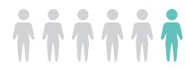
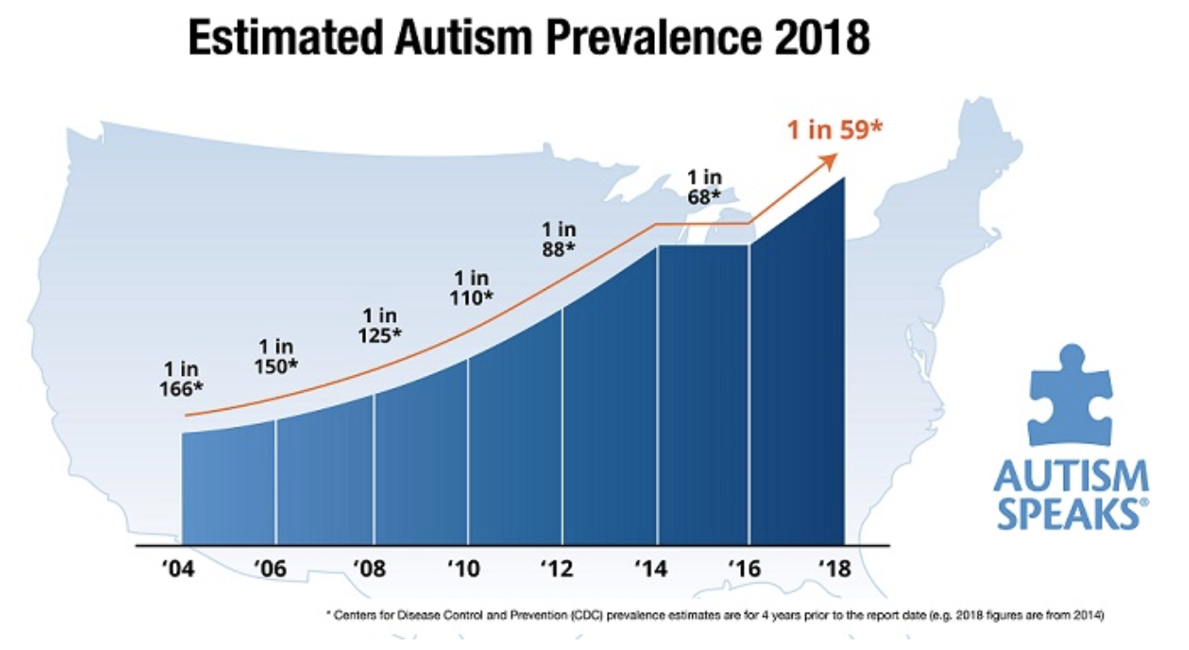
Child behavioral health conditions are common
1 in 6 children
HAS A developmental DISABILITY
About 1 in 59 children has been identified with autism spectrum disorder (ASD)
Approximately 11% of children 4-17 years of age have been diagnosed with ADHD
5-12% of US children between 2-5 years are affected by speech and language deficits.
- US Centers for Disease Control & Prevention (CDC),
- Wallace et. al. 2015
Notes:
Child developmental conditions on the rise. In fact, here in America, the CDC estimates that 1 in 6 children out there have some sort of dev. Disability: cognitive, social, linguistic, gross of fine motor function, etc.
The latest update from the CDC puts the prevalence of autism in US population at 1 in 59. And it is even higher than that among boys because it presents in more boys than girls. (4.5x)
ADHD affects more than 1 in 10 children, and S&L disorders up to 12% of young children.
So they’re pretty common. In this crowd there’s not one but several parents who have children with such conditions, whether they’re aware of It or not yet.

Slide 5
Behavioral health diagnostics are challenging
No definitive medical tests
No established genetic markers
Diagnosis based on phenotypes
Wide spectrum of behavioral presentation
Notes:
In addition to being common, behavioral health conditions are also hard to screen for or diagnose. It is often obvious that a particular child has some problem. But not easy to single out which.
There are no definitive/quantitative tests for such conditions:
- no blood test for ADHD like there is for diabetes or or chest xray like bone cancer
- no genetic test for Autism like there is for Down Syndrome
Diagnosis relies on observation of behavioral phenotype
And that phenotype varies wildly from case to case hence the term autism SPECTRUM disorder
In fact, there is a common saying among practitioners “Once you’ve seen an autistic kid, you’ve seen AN autistic kid”

Slide 6
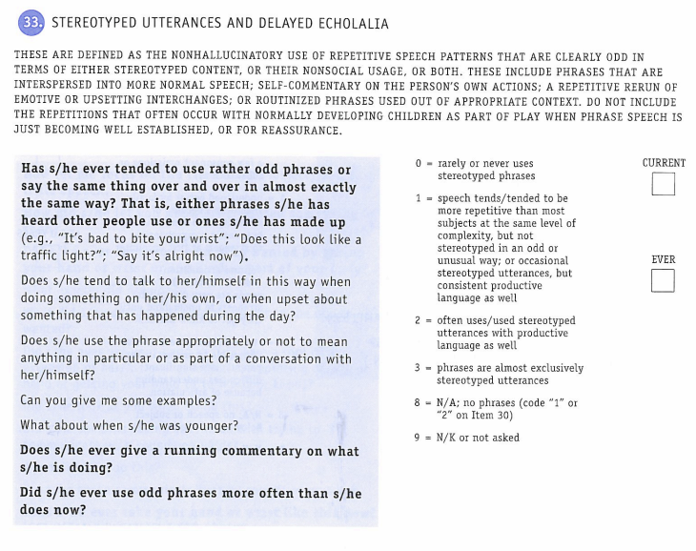
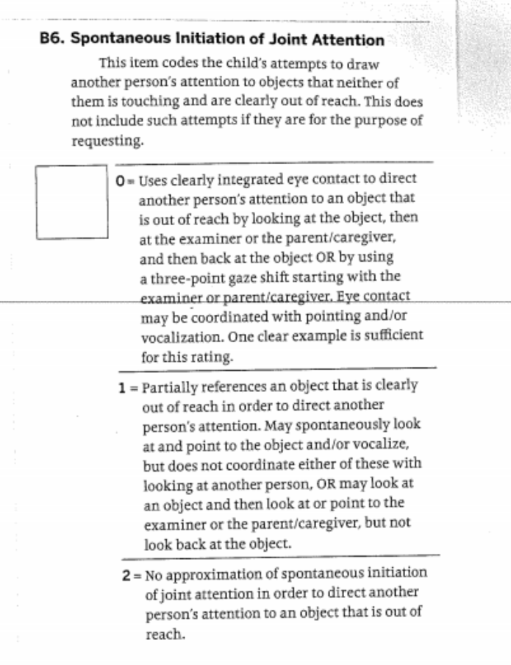
Diagnostic methods are primitive
Clinical setting
Expensive
Time consuming
Low tech (pencil and paper)
Too simplistic ( ∑codes > threshold )
Fall short in predictive value
Notes:
Yet the screening/diagnostic methods available to parents and clinicians hail from a world before the Information Age.
They consist mostly of pen and paper checklists: lengthy multiple-choice questionnaires to be answered by a highly trained practitioner after having interviewed the parent or observed the child directly in a highly standardized clinical environment (and I mean the toys are standard, the activities are standard, the cues are standard, even the wallpaper is standard)
Take a look at these examples from such checklists:
Notice how the questions/terms are very specialized / specific (Stereotyped utterances and delayed echolalia, Spontaneous initiation of joint attention)
Notice how the answers are categorical with codes against each answer choice
The codes are simply summed and compared to a static threshold to render an assessment
Because they’re so rudimentary in their linear summation of question answer codes, they often fall short in predictive value, and wind up producing too many false positives as byproduct of having to ensure high sensitivity to true positives.

Slide 7

Standard of care falls short
No Diagnosis
3 critical years lost
Uncertain parents
Delayed referrals
1 year + waits for diagnosis
Speech Delay
ADHD
Initial parent concern
Autism
1 Years
2 Years
3 Years
4 Years
5 Years
6 Years
7 years
Key developmental window for most effective intervention
Notes:
Because screening isn’t very accurate, and dx so cumbersome and time consuming,
the system gets bogged down with children waiting for diagnosis by specialists
Most of the backlog cases are false positives hogging the doctor’s time, while the kids in urgent need for care get delayed with the rest of them.
Average wait time to see a child behavioral neuropsychologist in America is 18 months. So while the parent generally starts to have concerns somewhere between the first and 2nd child birthday, average age of diagnosis lags a couple of years behind.
For example, avg Dx age for Autism in US is 4.17 years
Which is a big missed opportunity because that missed window of early intervention happens to be the most effective time to intervene, so that starting therapy in this key time window when the child’s brain is still rapidly rewiring itself is known to dramatically improve lifelong outcomes for affected children
(as in regular schooling vs special needs school etc.)
For ADHD the situation is worse, because it is typically not flagged until the child goes to grade school and starts falling behind.

Slide 8
AI can help
… but
Enable diagnostic/therapeutic services that are:
More timely
More sophisticated
Cheaper
Easier to apply
More scalable
Resistance to wide adoption
Data security & privacy
High bar of performance
Definitional noise
Parent and clinician subjectivity
Training set bias, sparsity, and shallowness
Notes:
So clearly this is an industry that can benefit from streamlined automation tools.
There is a huge unmet need that AI can help with. For example, uou can use machine learning to build classifiers to screen/diagnose certain conditions.
The automation means that the screeners could be: Cheaper/faster/more scalable/
BUT
Applying ML to the field of pediatric behavioral health comes with a unique combination of challenges.
of most relevance to this audience are perhaps data security and privacy challenges, so I’m going to focus on those today.
But I wanted to briefly mention a few others:
like the challenge of operating under very high predictive accuracy requirements in a field that touches the lives of families directly
and the noise that comes from blurred definitions of conditions especially the boundaries between different behavioral conditions.
and the challenges that come from working with second-hand accounts of children, which are necessarily subject to bias,

Slide 9
Agenda
Problem
Approach
Logistics
Notes:
Ok, so that’s the problem we’re set to tackle at Cognoa. Now let me tell you a brief summary of our approach to solving it, keeping in mind it is a work in progress

Slide 10
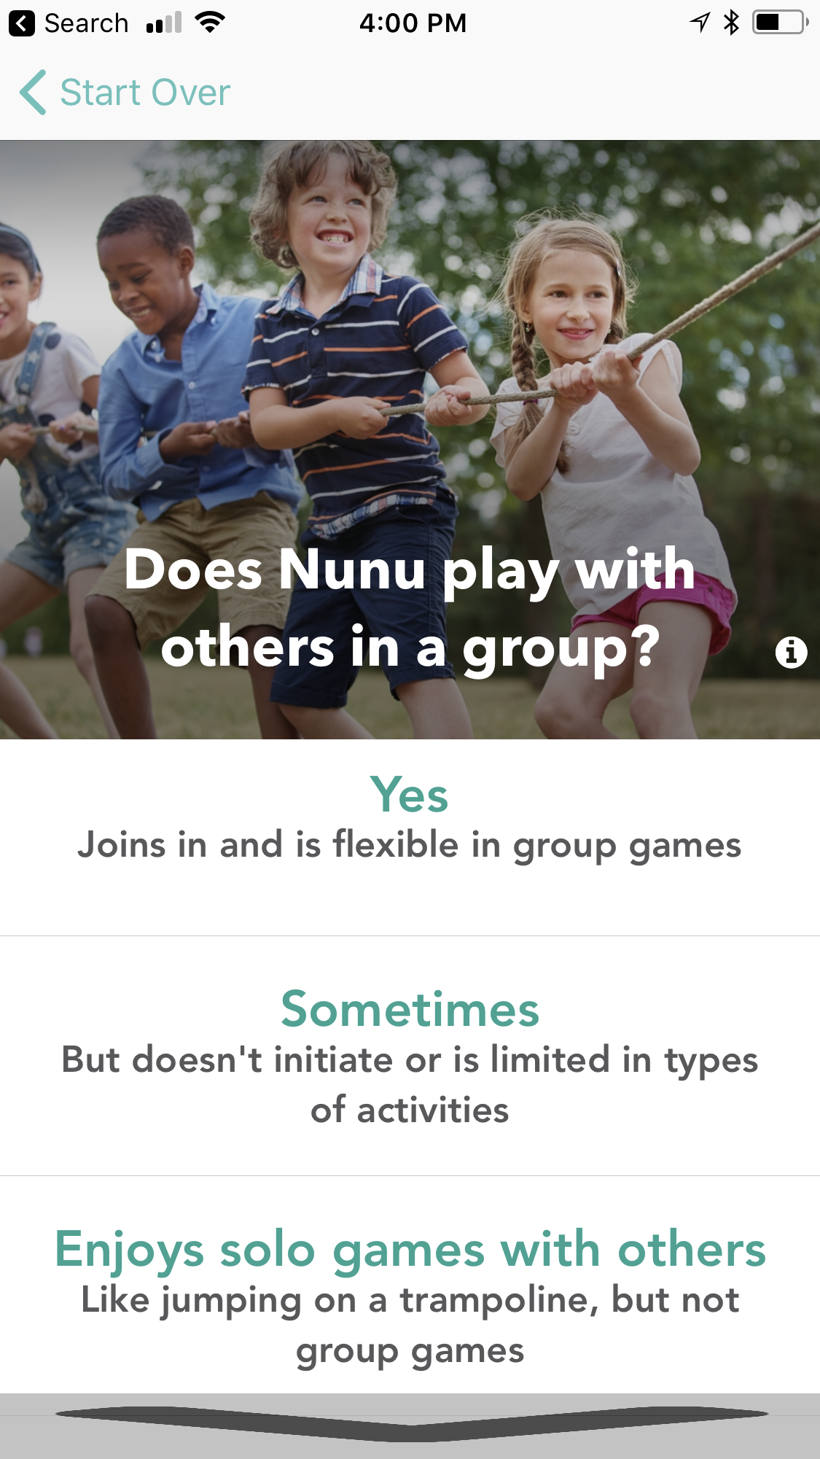
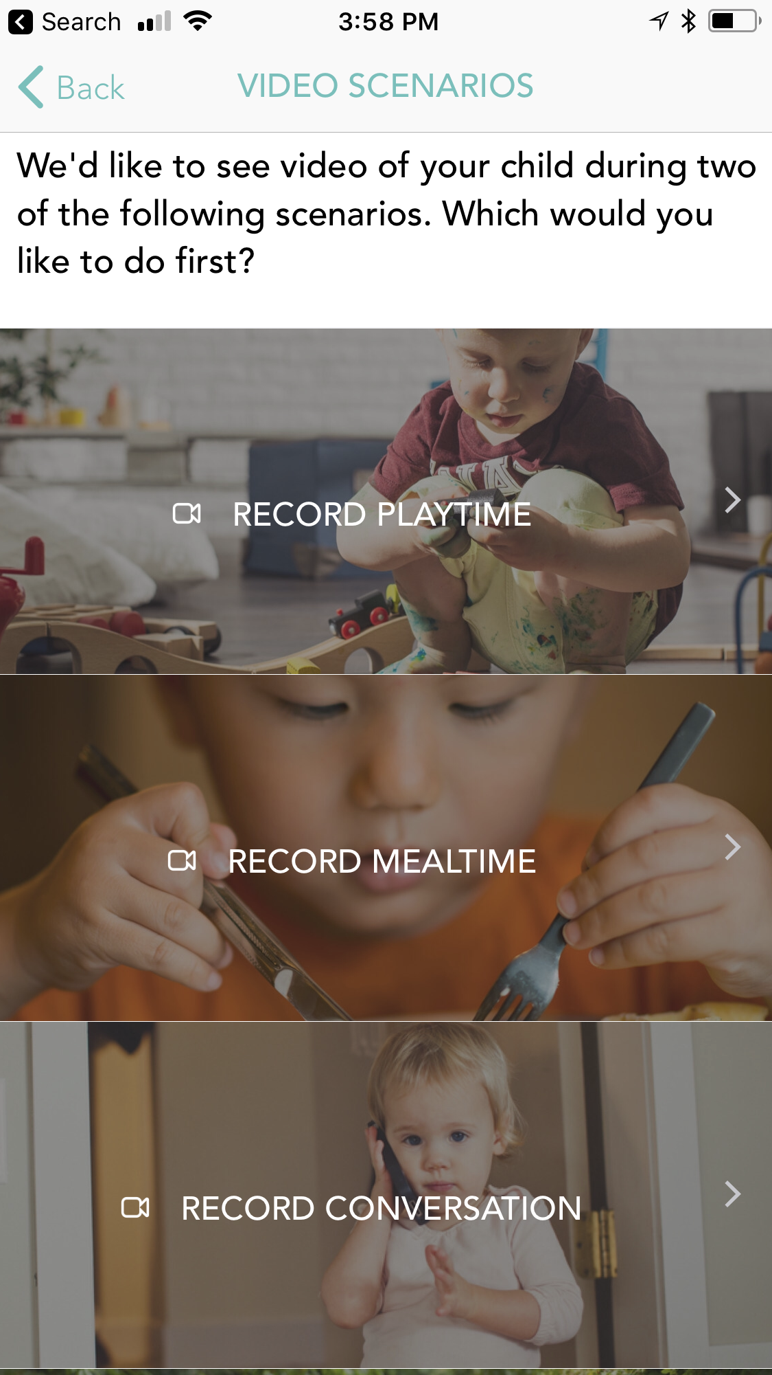

Our approach
+
+
+
Simple Questionnaire
Parents answer a multiple choice questionnaire to get preliminary results
Directed Videos
Parents upload a few videos of their children in specific settings
Interactive Sessions
Interactive storytelling, directed narration, video games
Doctor Questionnaire
Pediatrician optionally answers a few questions during checkup
Notes:
Our screening tools are delivered to parents via mobile apps. We use multiple modalities of information gathering – all unsupervised home-based and don’t require any prior training:
10 min questionnaire
A few 1-min directed videos
And automated, interactive story-telling sessions where we film the child while trying to engage her in a conversation about the story.
All the modules can be completed on the spot using a mobile device, at home, without prior training
Our diagnostic tools use all that data, in addition to a short questionnaire that we present to the family doctor or pediatrician, to be filled during a wellness visit.

Slide 11
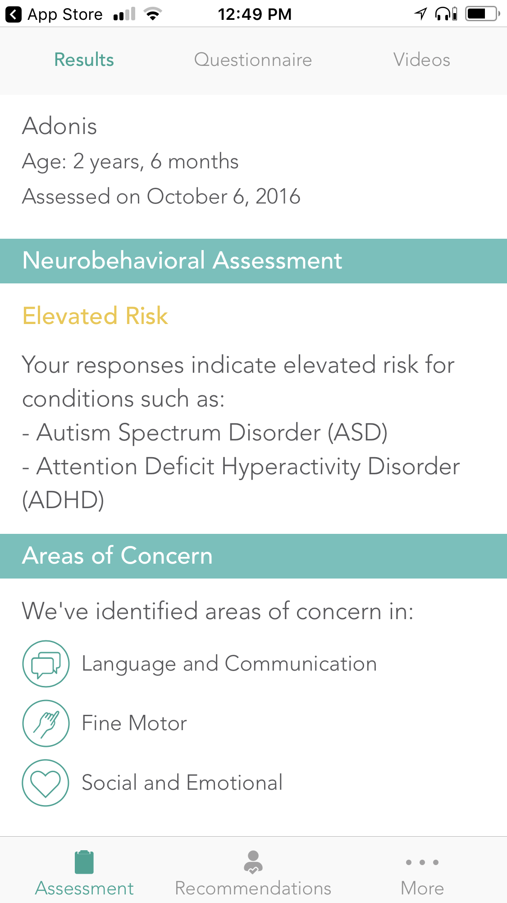
Our approach
Parent questionnaire predictive model
Home video predictive model
Interactive session predictive model
Doctor Questionnaire predictive model
(Machine Learning)
(Deep Learning)
(Deep Learning)
(Machine Learning)
Multi module fusion model
Diagnostic outcome
Notes:
Under the hood, we use pretrained ML and DL predictive models to render an assessment outcome for every modality, and then a multi-tiered combinatorial method joins the predictions from each assessment into a single diagnostic outcome.
The idea is that the modules provide complementary signals, each incomplete, each sparse, each subject to noise and bias, but together are demonstrably reliable

Slide 12
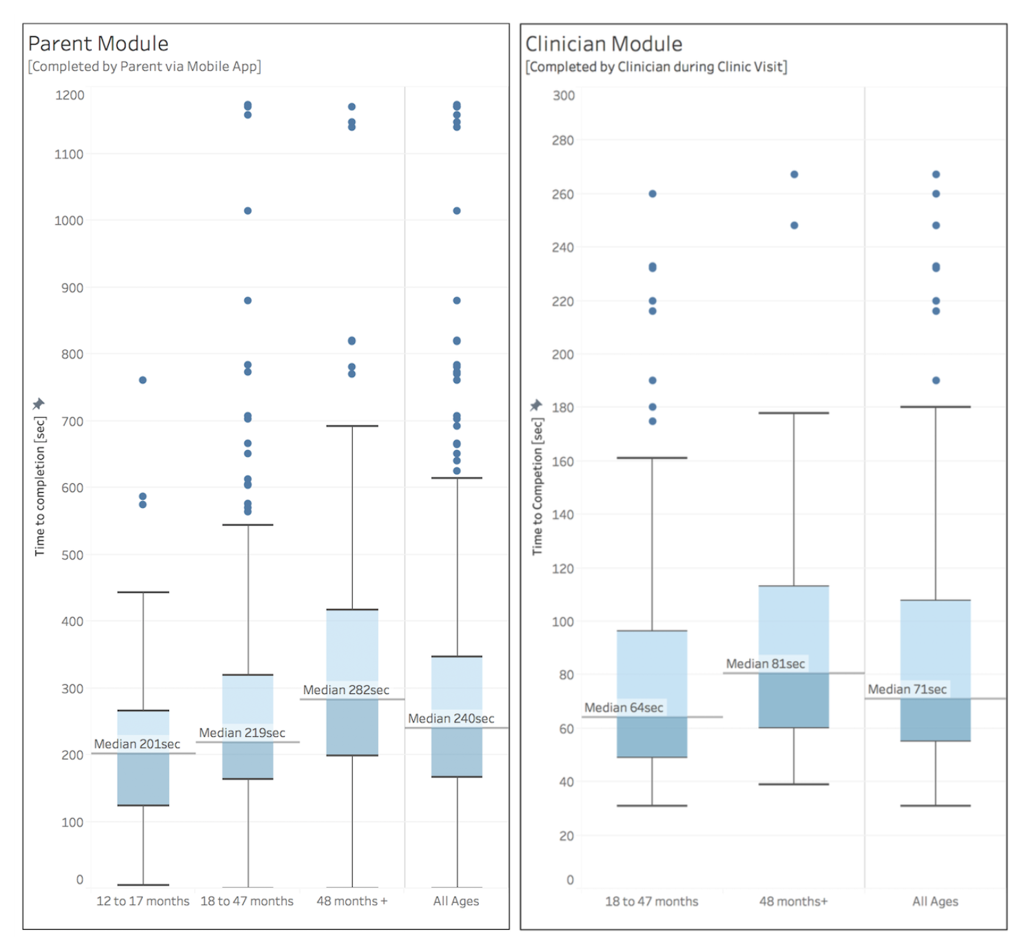
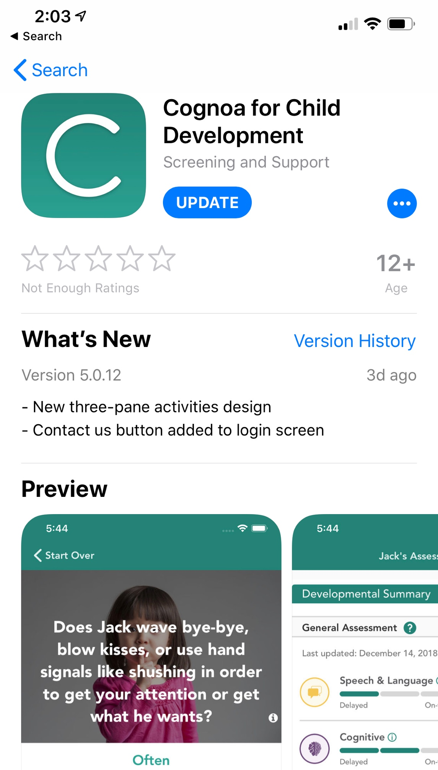
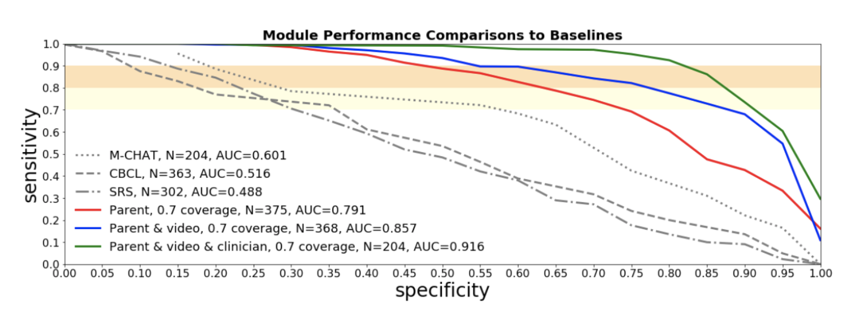

Our approach
accessible
fast
reliable
Notes:
Compared to the current standard of care, our system is more accessible: Any parent with a smartphone and internet connection can use it at a home setting without any training
Fast: Time to completion measurement under 10min for parents and under 5 min for clinicians. In cases where video analyst is involved, still well under 20min.
Accurate/Reliable: Clinical studies 2016/2017 show 85% sensitivity / specificity. Most recent version achieves 98%+ accuracy in retrospective data application. Current clinical studies underway to measure its prospective performance

Slide 13
Underlying predictive models
ASD
not sure
+
?
negative ASD
+
+
-
more input features
Which one?
+
not sure
+
ADHD
+
?
?
-
not sure
input features
Behavioral disorder?
-
negative ADHD
no
Notes:
Not to get too much into the details here, the underlying predictive models take on a “general-to-specific” approach, where the first set of inputs might be used to rule out some patients as not at risk for behavioral conditions, while the remaining patients might be channeled to a second or third, more involved assessment modalities aimed at discerning possible suspected behavioral conditions.
This divide and conquer approach best models the way physicians operate in the clinic, and is optimal in an industry where features are only available on demand via prescribed tests that might be costly run.

Slide 14
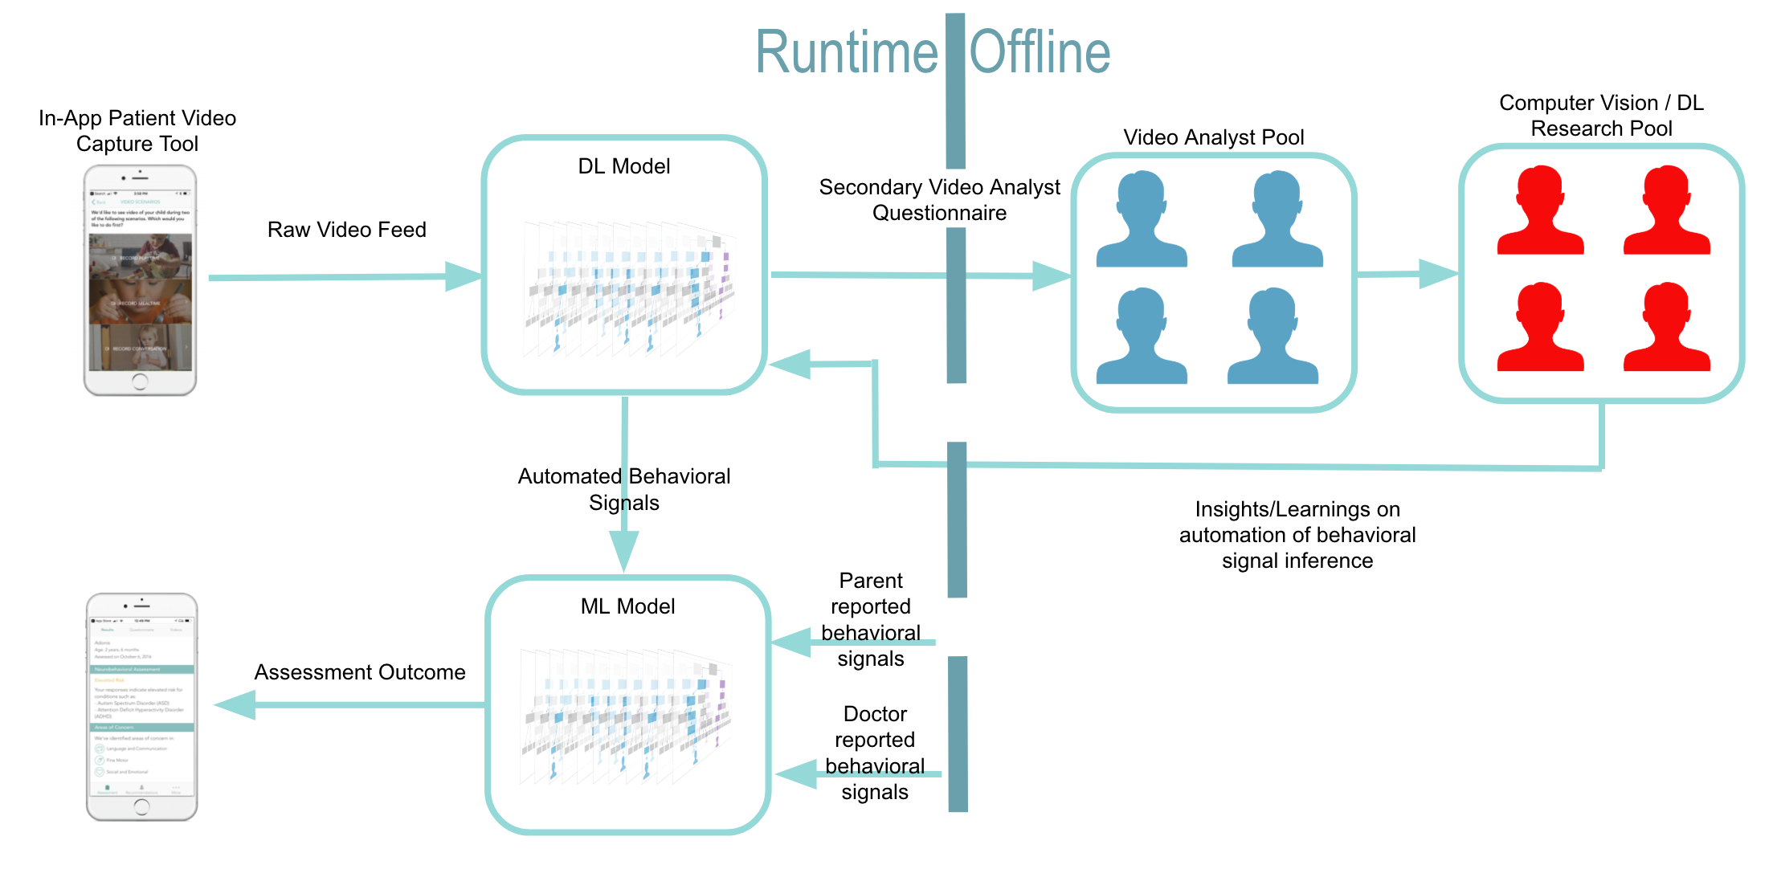
Perception module
Interactive Sessions
Notes:
SKIP 2 SLIDES IF LESS THAN 15 MIN REMAIN
Now I told you that some of our assessment modules analyze audio-visual feeds of children looking for behavioral clues. I want to tell you a little bit about how that works as a system.
Bats “behavioral atoms” as in smallest clinically relevant units of behavior that are amenable to computer-vision detection without having to rely on context too much
Example: Smile. Shrug. Point. Look away. Jump. Say a phrase. Laugh. etc.

Slide 15
Underlying Behavioral Fingerprinting
speech
speech
speech
smile
shrug
point
stand
surprise
laugh
point
sit
time
eye contact
eye contact
eye contact
audio features
video features
higher order features
size of vocab
intonation
conversational rapport
…
quality of eye contact
variable facial expression
pointing
…
level of engagement
attention span
sharing enjoyment
…
Notes:
Bats “behavioral atoms” as in smallest clinically relevant units of behavior that are amenable to computer-vision detection without having to rely on context too much
Example: Smile. Shrug. Point. Look away. Jump. Say a phrase. Laugh. etc.
Having automatically processed the footage of a child assessment session into a sequence of BATS, we then run ML to analyze the bat sequences and create higher-order features that have clinical relevance.
Examples.
Those higher-order features are then input into the overall system of Dx/Tx along with the features from every other assessment module (parent Q, clinician Q, etc.)
This approach has the advantage of better explain-ability than the alternative black-box computer vision deep neural network. explain-ability is very important in healthcare.

Slide 16
Agenda
Problem
Approach
Future
Notes:
So this was a very brief overview of our approach to automating child behavioral diagnostics.
Finally I share with you some thoughts about what I think the future of AI-in-healthcare might hold and what exciting developments we might expect to revolutionize child behavioral healthcare in the years to come.

Slide 17
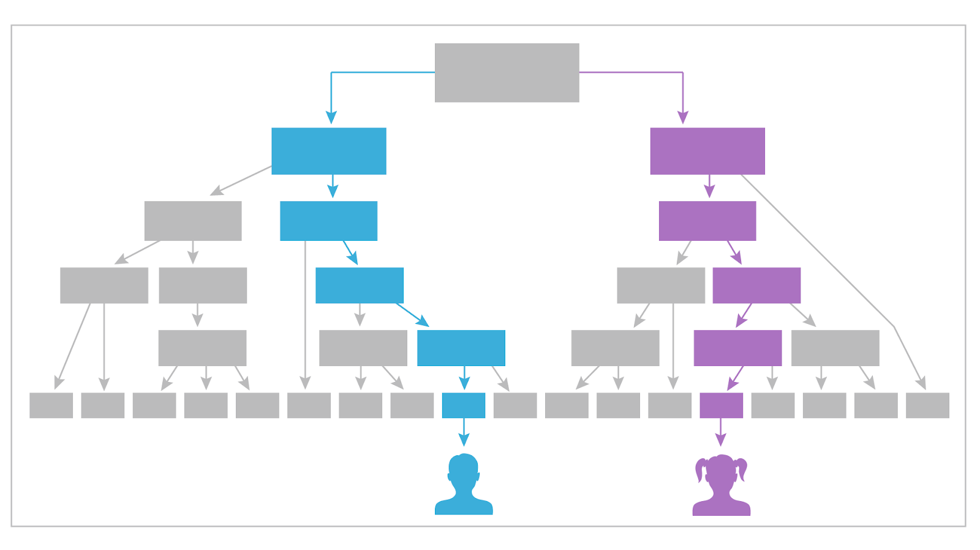
Near Future: Role reversal
Notes:
One prediction that I’m going to leave you with today about the future role of AI to revolutionize child behavioral healthcare is that :
In the near future, we are going to see in the future a reversal of the roles between human and machine clinical expertise.
Allow me to explain what I mean by that:
Generally when we think of applying AI to healthcare nowadays, we generally mean to train AI algorithms to learn from historical patient data labeled by clinicians, in order to get AI to best mimic what a clinician would have observed//diagnosed/prescribed of any particular incoming patient in the future.
In short, we’re trying to get AI to catch up to what human doctors can already do.
But that’s not going to be the case in future. Take a look at this example AI-learned decision tree, as applied to two patients placing them in different bins according to them presenting with different clinical inputs.

Slide 18
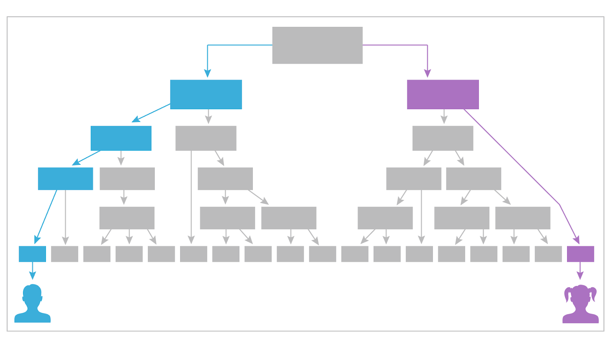
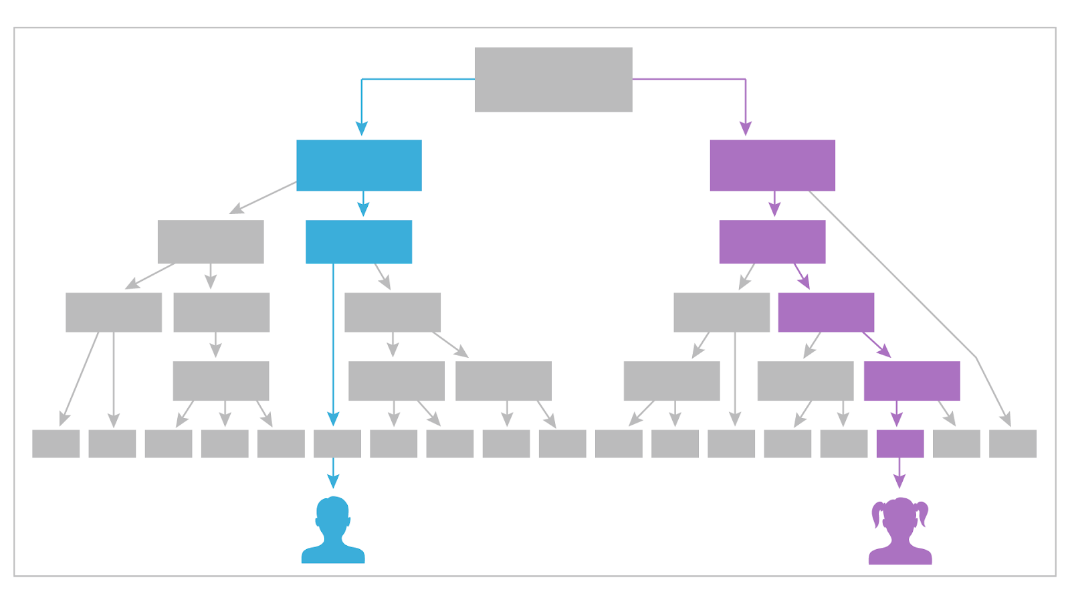
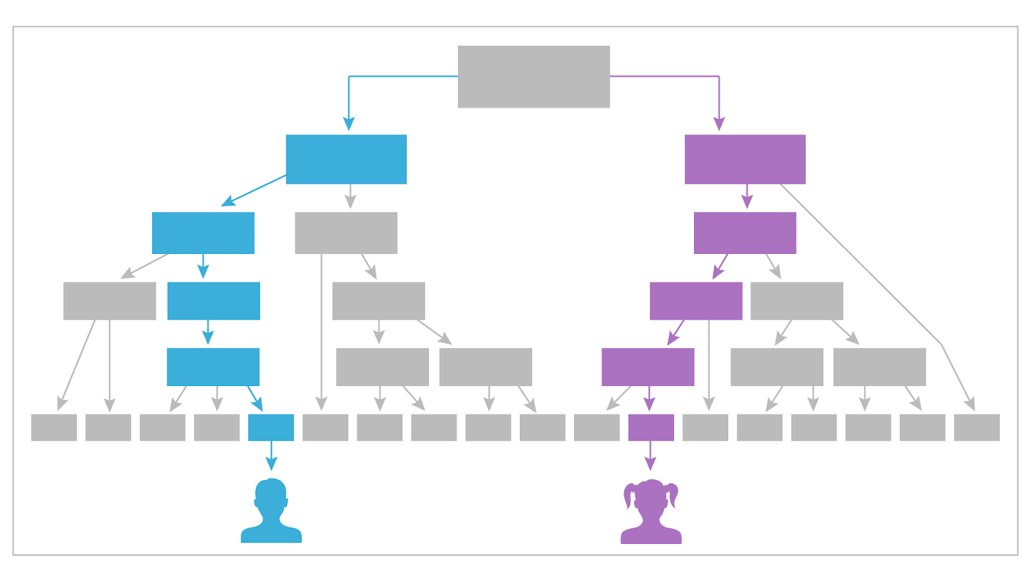
Near Future: Role reversal
Notes:
Of course in practice and AI system is composed of many different such discriminatory models, I’m showing 6 different trees of a single ML tree-ensemble model. The AI places each patient in 6 bins, one per decision tree

Slide 19
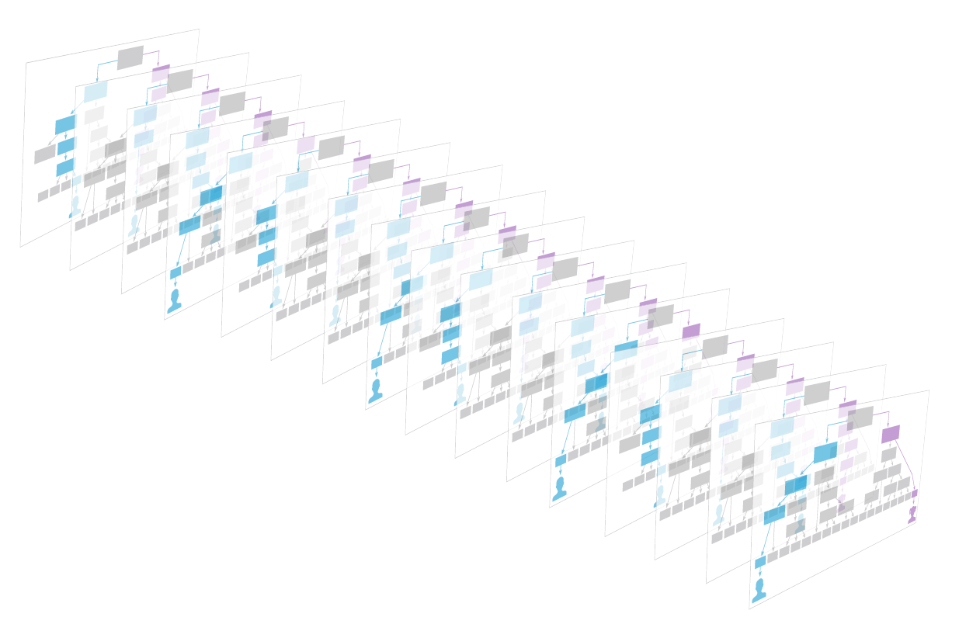
Near Future: Role reversal
200x
Notes:
Now expand the number of trees into a practical number like 200 or so.
What you have done here is a projection into a high dimensional virtual space made possible by the application of AI on a volume of data too large to draw inference from by any human clinical expert

Slide 20
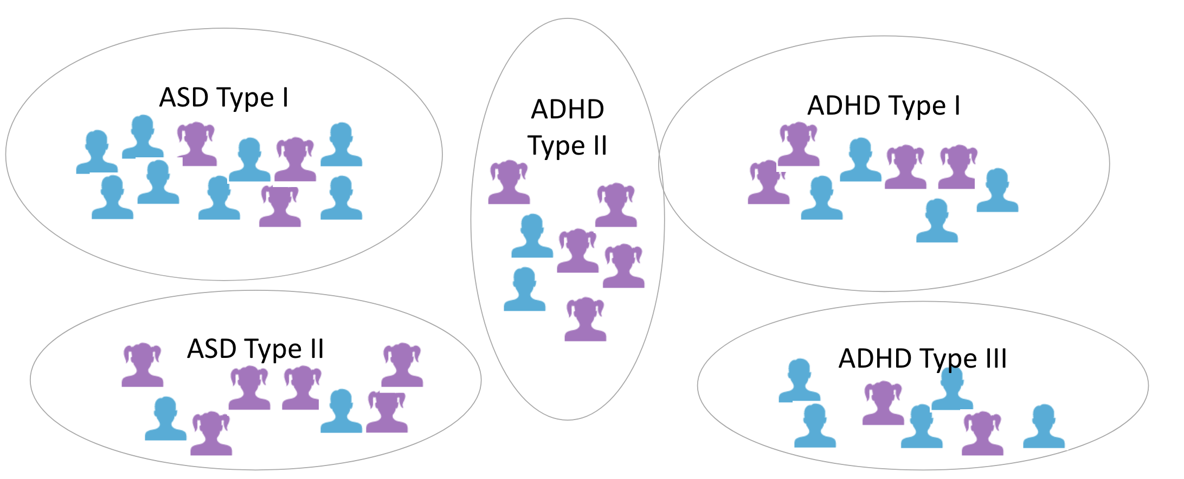
Near Future: Role reversal
Notes:
Projection onto lower dimensional space reveals novel empirical behavioral clusters of “sub-types” of each condition
Data driven clusters might clue on very subtle patterns, not necessarily recognized or even recognizable the experts of the field.
To give an example: I had a DS colleague point out to me demonstrably that the ratio of “um” to “uh” in phrasal speech happens to be a relevant dimension when it comes to clustering ASD patients – no child behavioral specialist is currently aware of the relevance of such behavior as far as I know, and I have discussed the matter with quite a few specialists.

Slide 21
Near Future: Role reversal
INTERVENTION B
INTERVENTION A
Notes:
Clusters identify cohorts for therapeutic intervention
Empirical clusters, precision therapeutics, insights distilled from the aggregate wisdom of thousands of clinicians over decades of healthcare – no one clinician or committee can rival that prospect in breadth or in scale
It might turn out for example, that one particular sub-type of what we call ASD might respond well to the same treatment as a particular sub-type of what we call ADHD, and so on
And so now you have data science leading the way in clinical science, rather than playing catch up!

Slide 22


Epistemology of the future
Notes:
Fundamentally I think there tends to be two schools of thought when it comes to considering the role of an emerging technology in shaping the future of an industry: I like to call them the Occam way, and the DesCartes way.
The Occam school of thought assumes the future would unfold in the simplest possible way. So that an emerging technology would be applied to an existing industry in the most obvious, most intuitive way. Typically to replace one particular element with another – improved version that accomplishes the same task more efficiently. Sort of like replacing the your old incandescent light bulbs with new LED lights that fit into the exact same sockets but use much less energy.
A DeCartes future, on the other hand, is not as intuitive. It consists of fundamentally reinventing the industry in light of the new possibilities made available by the advent of the emerging technology.
That’s what I like to think is about to happen to pediatric behavioral healthcare.

Slide 23
Far Future?
Notes:
I want to end this talk with a brief discussion of how AI might revolutionize pediatric healthcare in the far future, say decades from now – even though predictions at such timescale are admittedly speculative at best.
But what might pediatric healthcare look like in a world where automated agents are ubiquitous?
The straight forward expectation would be that doctors would be replaced with AI agents. Instead of visiting a doctor, you’ll find some sort of AI entity at your disposal at the clinic or hospital, and whatever you’d expect the doctor to do, now the AI agent does.

Slide 24
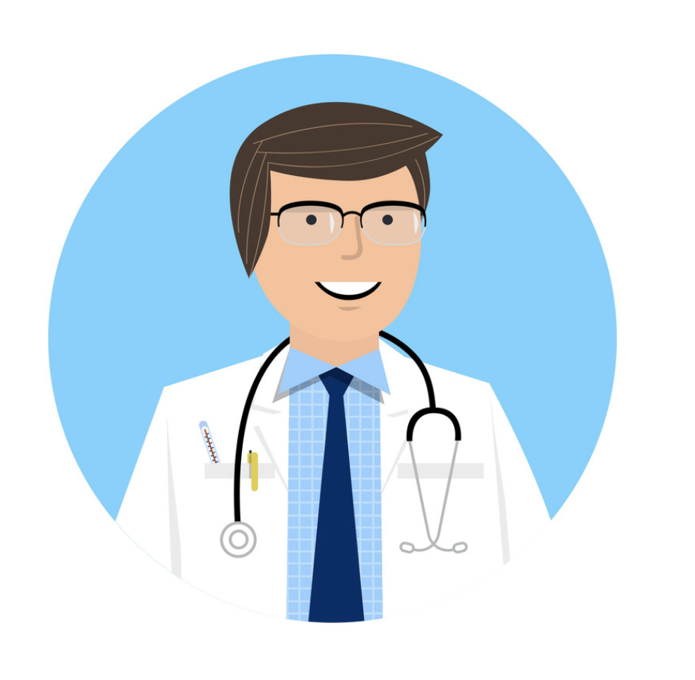
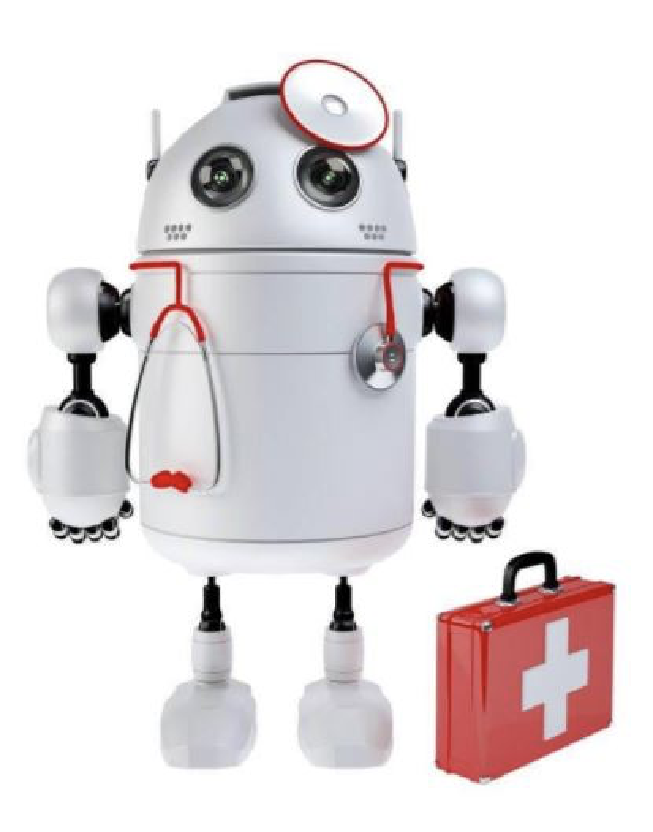
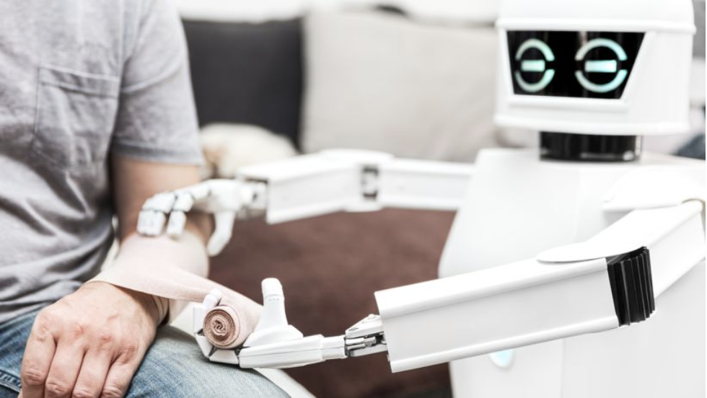
Far Future?
Notes:
… sort of like this
You might think that’s naïve but that’s actually how we all expect the future to unfold most of the time – I mean I’m not making this stuff up, this picture is from an actual headline on a major news network network. The public perception is largely like that!
If you think about it, this is sort of the Occam’s razor way of thinking: When a new technology is applied to an existing industry, it changes it in the simplest way possible: you take an element out of the industry and replace it with an equivalent element made possible by the new technology.
The best analogy I can think of is from the end of the 17th century, when the internal combustion engine started to go mainstream and people were getting excited about the potential of that new technology to revolutionize personal transportation.
At that time, personal transportation was limited to carriages pulled by horses and oxen.

Slide 25

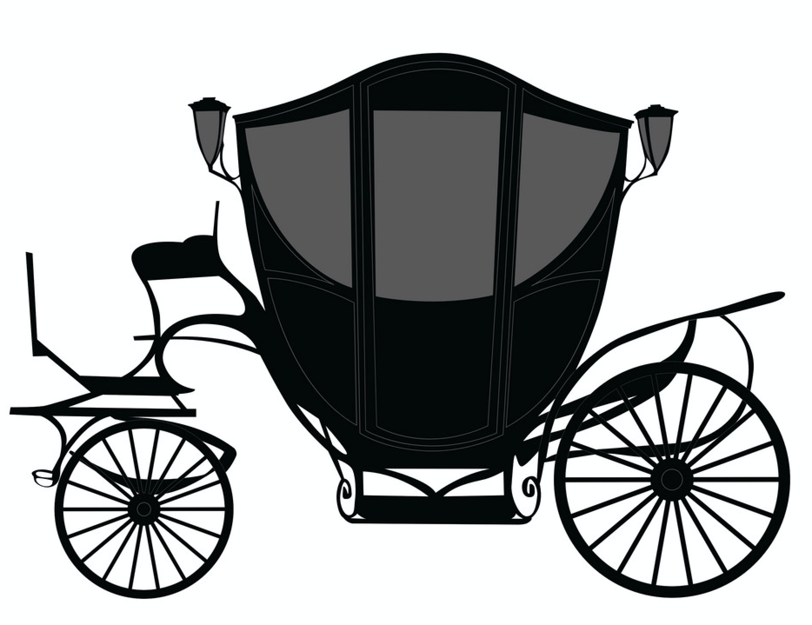
Far Future?
Notes:
So naturally people started thinking about revolutionizing the horse carriage in the simplest way possible: To take out the horse and replace it with a MECHANICAL alternative powered by an internal combustion engine. And you get a horseless carriage.
While that would be the most intuitive way to apply the new tech, it wasn’t at all practical or cost-effective. In fact, history will show that it can only be a stepping stone while society wraps its head around the newly emergent possibilities.
Eventually, entrepreneurs started to realize that what made sense was NOT an automated version of what already existed, but rather a new thing altogether. So not a horseless carriage, but an entirely new thing that had nothing to do with a carriage.

Slide 26



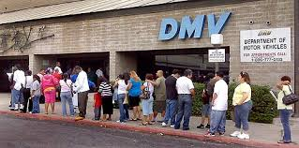
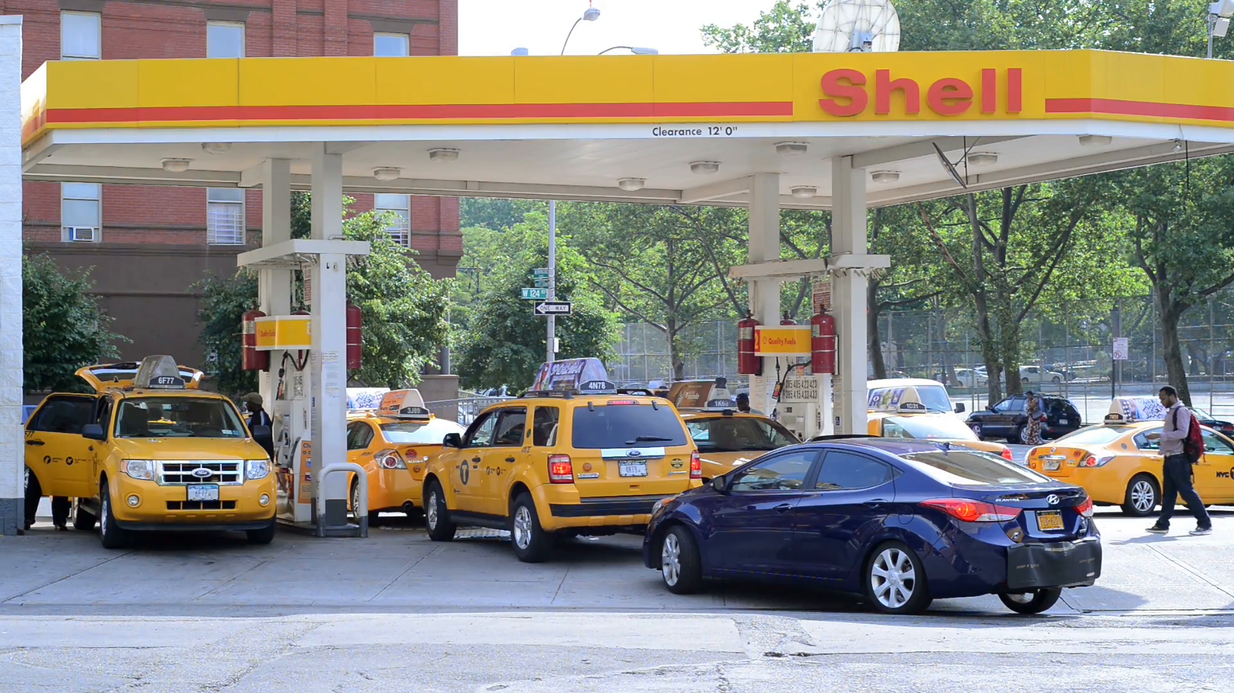
The future of the carriage
Notes:
That line of thinking opens the door to daring new ideas. Once you realize that a horseless carriage is not only horseless, but it doesn’t even need to be a carriage at all.
Once you stop thinking carriage, and start thinking automobile, you start a journey of transformation that encompasses not just the carriage, but the entire fabric of society.
New systems arise, like highway networks, traffic signs, bus routes, driving schools, and even suburban communities.
New institutions replace obsolete ones, like gas stations replacing stables for example. New resources like oil and rubber become essential. New industries spring, like car manufacturing and oil drilling. New issues arise, like traffic pollution and drunk driving.
Such developments would have been next to impossible to envision from the point of view of the innovators busy at work back in the 1800s trying to build better carriages.
So if we were to attempt the impossible here – I think something similar to that transformation is about to happen to healthcare in general, and to pediatric behavioral healthcare in particular.

Slide 27
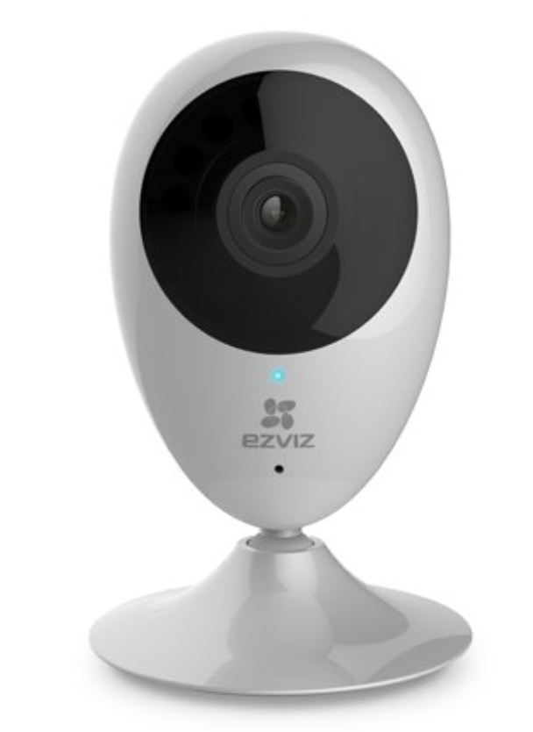
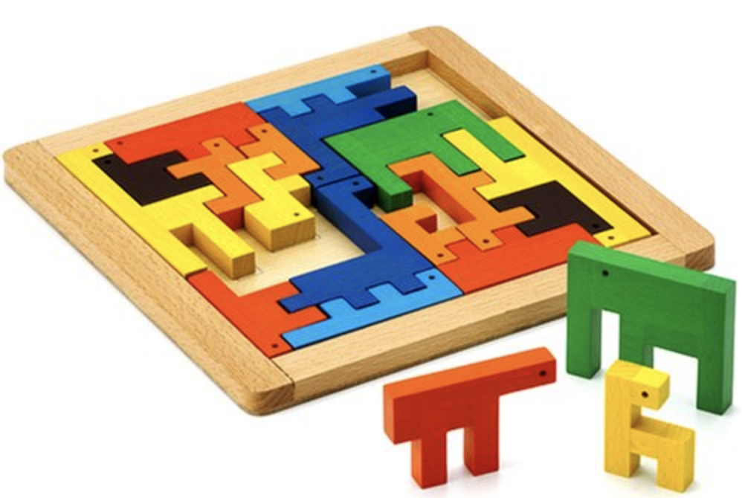
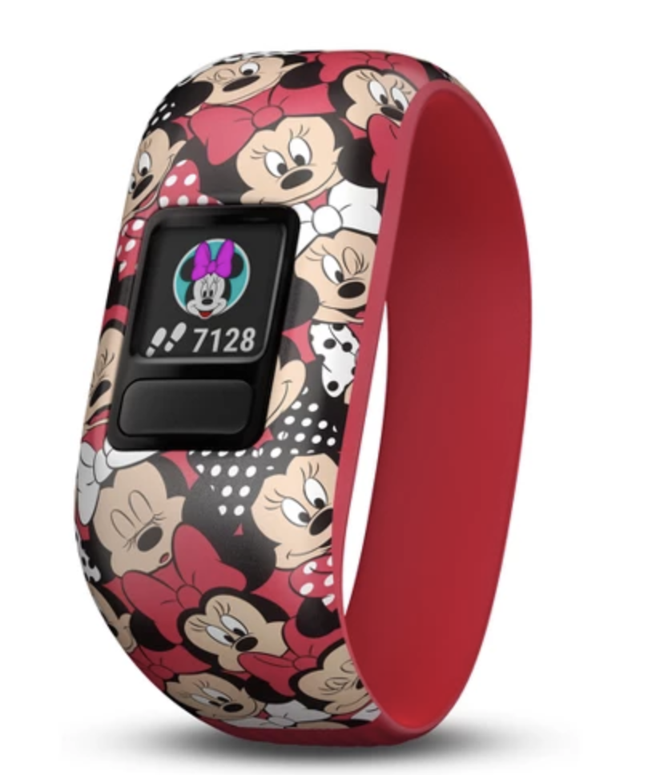
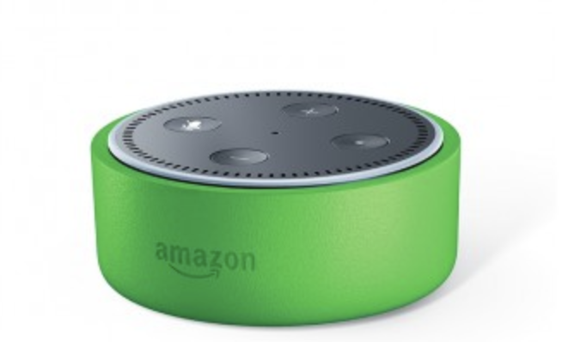
The future of pediatric behavioral healthcare
Screening
Diagnosis
Behavioral Intervention
Progress Tracking
Monitoring
Notes:
When you have the facility to apply an automated agent with the smarts to render diagnostic and therapeutic services and the bandwidth to do it continually, cheaply, accurately, at scale, and without downtime, you no longer need to do it in a prescriptive, reactive way at all!
Here’s what’s NOT going to happen. We’re not going to take the doctor out of the equation, and replace him/her with an AI robot doctor stationed in a clinic for patients to visit and receive diagnoses and prescribed therapy plans.
I think the future of behavioral healthcare will be characterized by a passive, seamless, ever-present suite of services that blur the current boundaries between what we think of as screening vs diagnosis vs intervention/therapy vs progress tracking and monitoring.
I think in the future we will stop thinking of these as distinct elements in a waterfall process, and start thinking of them as aspects of an integrated whole package, made possible using a wide set of everyday household items.
Wearables, mobile touch screen devices, voice assistants, and even toys and passive home monitors.
Each of these devices continually does its part to complete the digital picture about your child behavioral health.
Whether you take a video of your child on a vacation or buy her a new jigsaw puzzle to play with, or a watch to wear or a doll to dress, or a coloring book, every device would employ its sensors to piece together a complete picture of your child’s cognitive development, and make assessments continually about whether things are on track on every dimension that matters. And make decisions about how best to personalize the forecasts, expectations, and skill-building activities to match your child’s individual needs and characteristics.
Behavioral healthcare will no longer be a tool reserved for those with delays or cognitive disorders, but rather for every child according to their individual needs to reach their full developmental potential
Of course, clinical experts will still have an important role in this setup, but their role will be more of a supervision and confirmation than active observation and case by case decision making. Healthcare will basically take on a life outside of the narrow confines of the clinic and into the wide arena of everyday life.
That’s all I wanted to share with you today. Thank you for listening and I will take questions.

Slide 28
Thank You
Halim Abbas
Chief AI Officer - Cognoa Inc.
Apr 2019

